Slide 1
Queues

Slide 2
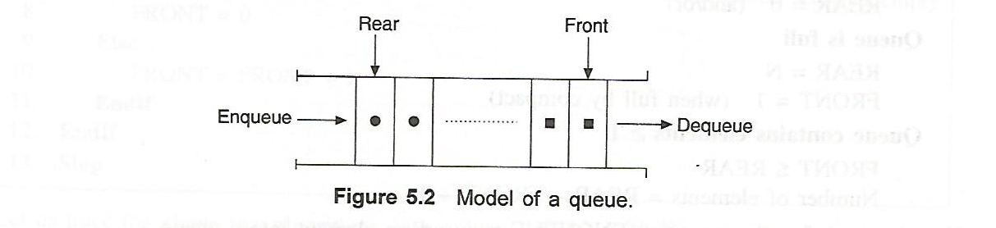
Definition
A queue is a linear structure where the ordering of elements is in a linear fashion.
In a queue insertion and deletion operations take place at two ends.
The queue insertion called ENQUEUE takes place at the REAR.
The deletion called DEQUEUE takes place at the FRONT.
An element in a queue is termed ITEM
The number of elements that a queue can accommodate is termed LENGTH.
The queue is also termed as first-in-first-out (FIFO)

Slide 3
Application of queues
Waiting lines
Round-robin scheduling in processors
Input/Output processing
Queueing of packets for delivery in networks
Access to shared resources (e.g., printer)
Multiprogramming
All types of customer service software (like Railway/Air ticket reservation) are designed using queue to give proper service to the customers.

Slide 4
Implementation of queue
A list or collection with the restriction that insertion can be performed at one end (rear) and deletion can be performed at other end (front)
Array based implementation
Linked list based implementation

Slide 5
Main Queue Operations
Main Queue Operations
enqueue(object): inserts an element at the end of the queue
object dequeue(): removes and returns the element at the front of the queue
Auxiliary queue operations:
object front(): returns the element at the front without removing it
integer size(): returns the number of elements stored
boolean isEmpty(): indicates whether no elements are stored.

Slide 6
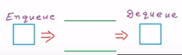
Basic operations of queue
Enqueue (obj)
Dequeue ()
Is empty ()
Is full()
front= f
rear = r

Slide 7
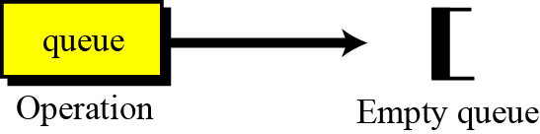
Operations on queues
Although we can define many operations for a queue, four are basic: queue, enqueue, dequeue and empty, as defined below.
The queue operation
The queue operation creates an empty queue. The following shows the format.
The queue operation

Slide 8
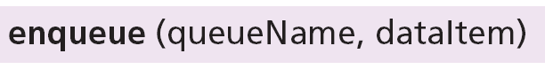
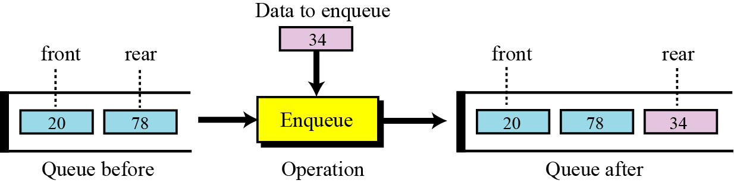
The enqueue operation
The enqueue operation inserts an item at the rear of the queue. The following shows the format.
$ $
Front
Rear
The enqueue operation

Slide 9
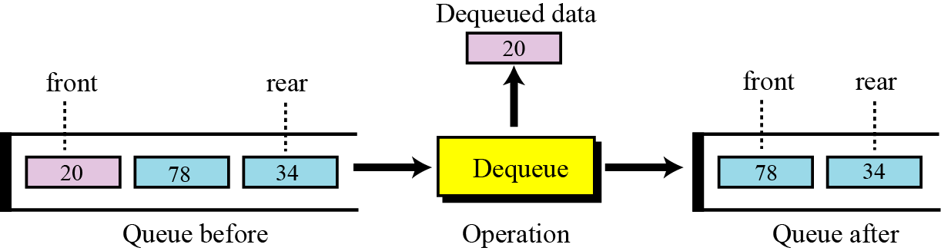
The dequeue operation
The dequeue operation deletes the item at the front of the queue. The following shows the format.
$ $
Front
Rear
The dequeue operation

Slide 10
The empty operation
The empty operation checks the status of the queue. The following shows the format.
This operation returns true if the queue is empty and false if the queue is not empty.

Slide 11
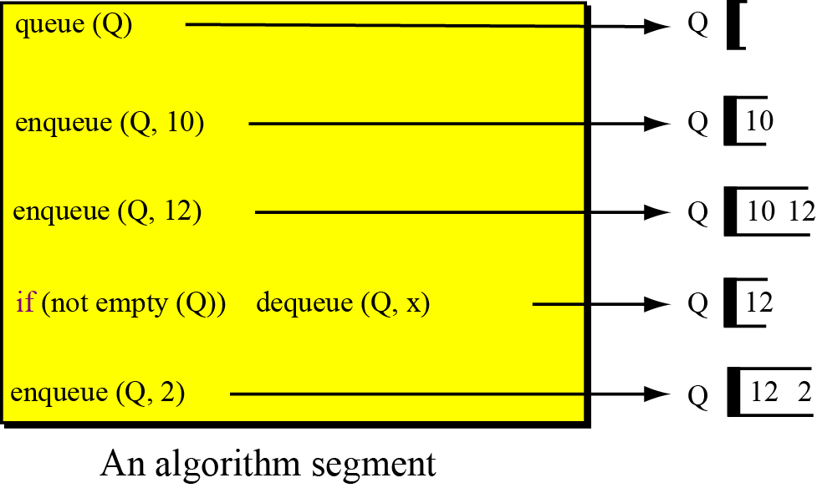
Example
A segment of an algorithm that applies the previously defined operations on a queue Q.

Slide 12
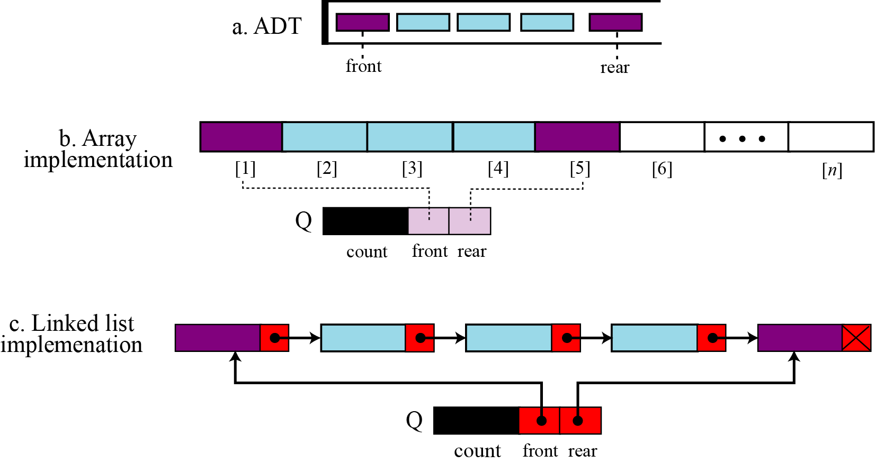
Implementing a Queue

Slide 13
Implementing a Queue
Using an array to implement a queue is significantly harder than using an array to implement a stack. Why?
Unlike a stack, where we add and remove at the same end, in a queue we add to one end and remove from the other.

Slide 14
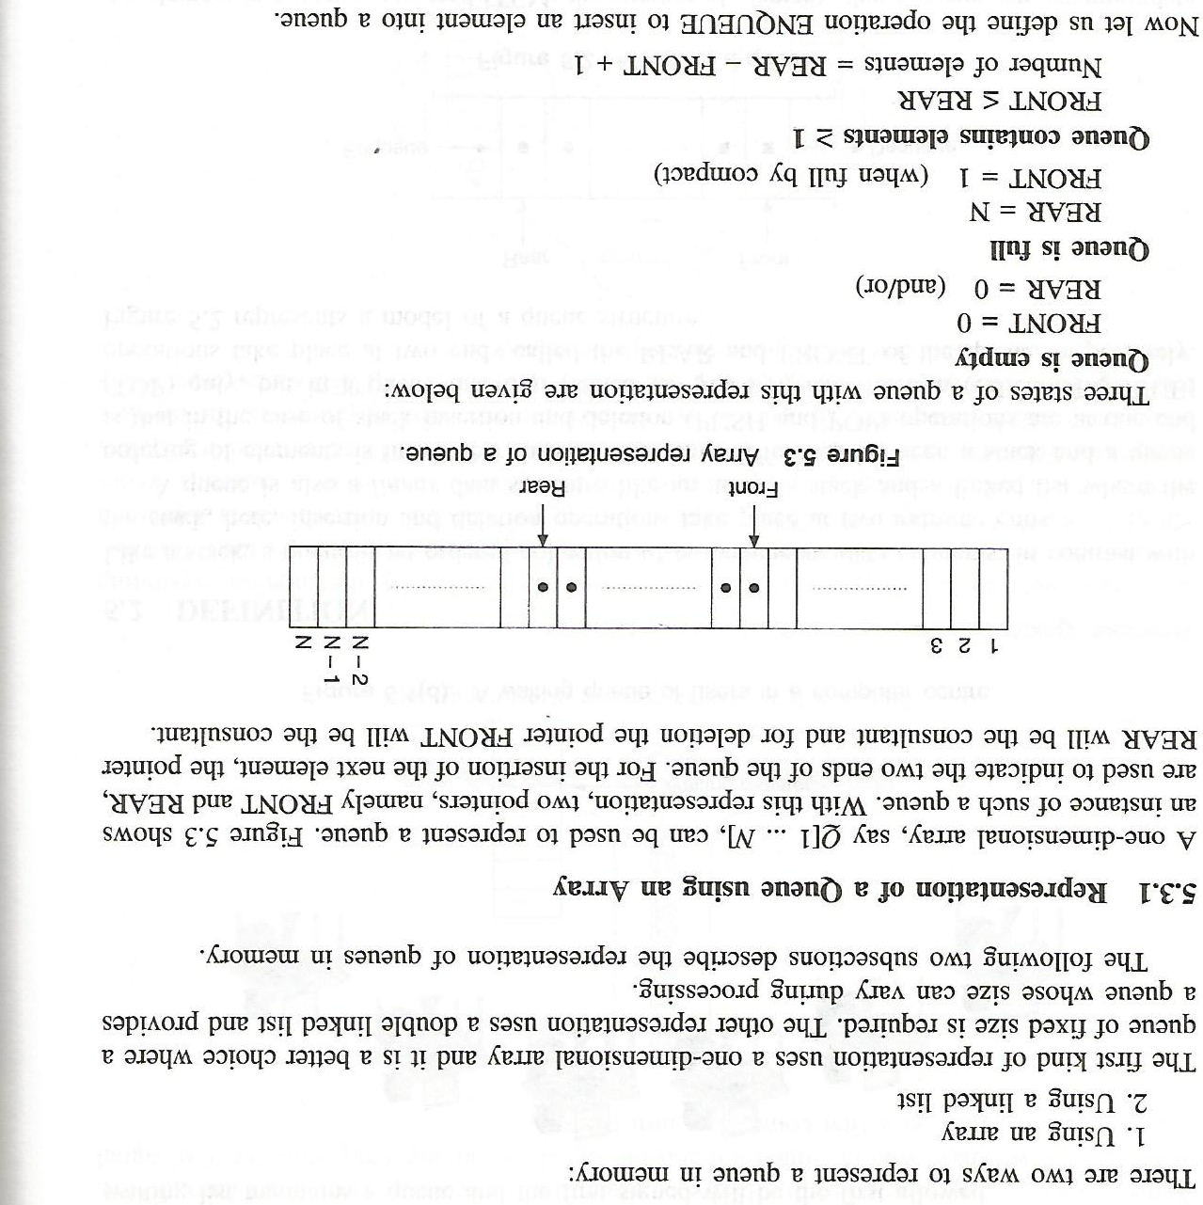
Representation of a Queue using an Array

Slide 15
Array implementation of queues
0 1 2 3 4 5 6 7
myQueue:
17
23
97
44
front = 0
rear = 3
To insert: put new element in location 4, and set rear to 4
To delete: take element from location 0, and set front to 1

Slide 16
Array implementation of queues
front = 0
rear = 3
Initial queue:
17
23
97
44
After insertion:
17
23
97
44
333
After deletion:
23
97
44
333
front = 1
rear = 4
Notice how the array contents “crawl” to the right as elements are inserted and deleted
This will be a problem after a while!

Slide 17
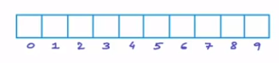
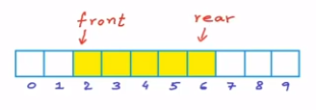
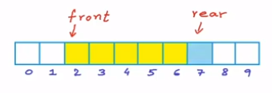
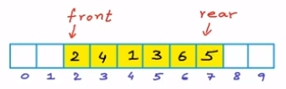
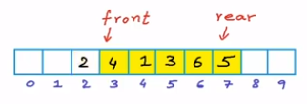
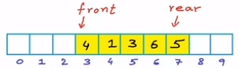
Implementation of queue
Array based implementation
Int A[10]
Enqueue(obj)
Front = 2
Rear= 6
After enqueue new rear index is 7
Dequeue() (e.g. remove 2 from queue)
To dequeue just Simply increment front
F=f+1

Slide 18
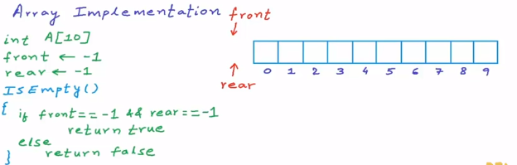
Empty function
From empty queue we set
Front =-1
Rear= -1

Slide 19
Is full function
Isfull ()
If rear == size -1
Print “ queue is full”
Or
isFull()
Return (size==r)

Slide 20
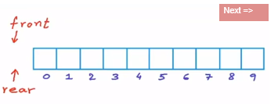
Enqueue(x)
{
if isFull ()
Return()
Else if isEmpty()
{
front ← rear ← 0
A[rear] ← x
}
Else
Rear ← rear +1
A[rear]⬅x
}

Slide 21
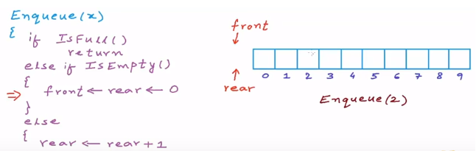
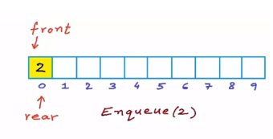
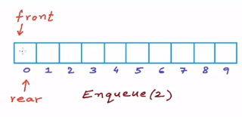

Slide 22
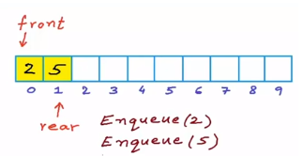
Enqueue(2) // queue was empty Enqueue(5) // queue not empty rear=rear+1 a[rear]=x

Slide 23
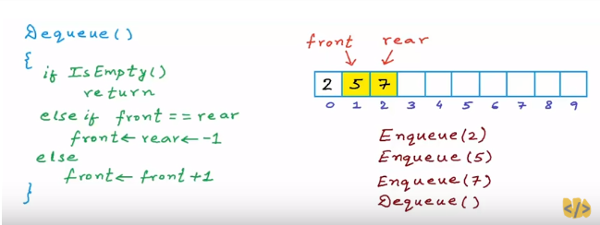

Slide 24
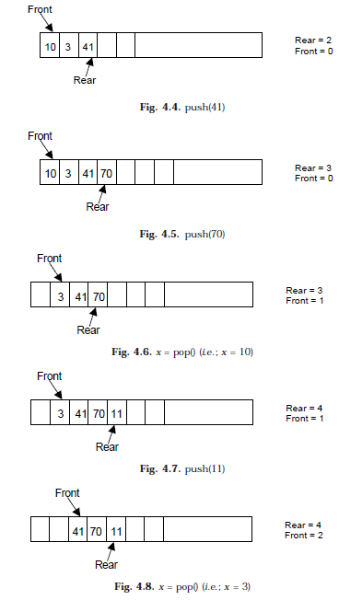
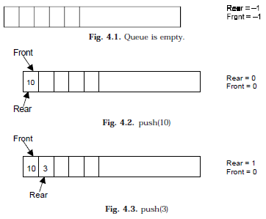
Example(Array Implementation)

Slide 25
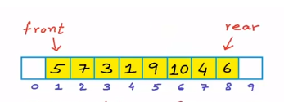
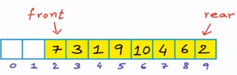
Enqueue(2)
Enqueue(5)
Enqueue(7)
dequeue( )
Enqueue(3)
Enqueue(1)
Enqueue(9)
Enqueue(10)
Enqueue(4)
dequeue ()
Enqueue (2)
*now we cant enqueue any more we cant increment rear although we have 2 cell left
To over come this we use circular arrays

Slide 26
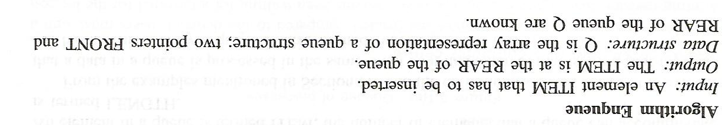
Initialize front=0 & rear = –1
Input the value to be inserted and assign to variable “data”
If (rear >= SIZE)
(a) Display “Queue overflow”
(b) Exit
Else
(a) Rear = rear +1
Q[rear] = data
Exit

Slide 27
Dequeue algorithm
If (rear< front)
(a) Front = 0, rear = –1
(b) Display “The queue is empty”
(c) Exit
2. Else
(a) Data = Q[front]
3. Front = front +1
4. Exit

Slide 28
PROGRAM TO DISPLAY ALL QUEUE ELEMENTS
//Displaying all the elements of the queue
void display()
{
int i;
if (front == –1 || front > rear) //Checking whether the queue is empty or not
{
printf (“\nQueue is empty\n”);
return;
}
else
{
printf(“\nQueue is :\n”);
for(i=front;i<= rear;i++)
printf(“%d ”,queue_arr[i]);
printf(“\n”);
}
}/*End of display() */

Slide 29
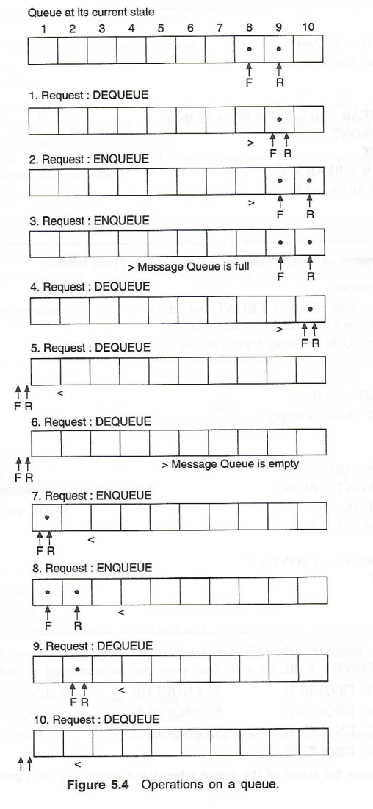
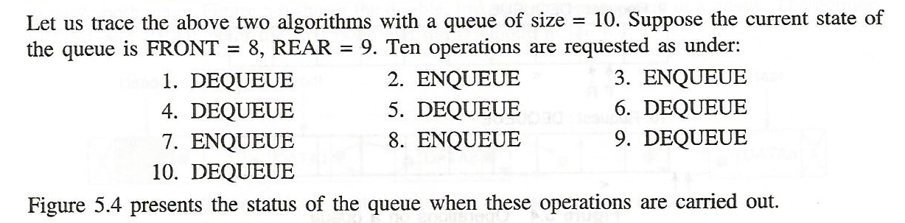

Slide 30
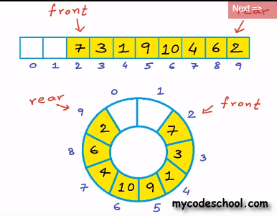
Circular array
Current pos=I
Next pos = (i+1)%N
i=N-1
Next N%N=0
Previous pos=(i+N-1)%N

Slide 31
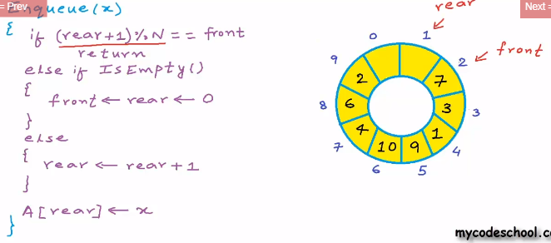
IsEmpty () // remain same Enqueue(x)

Slide 32
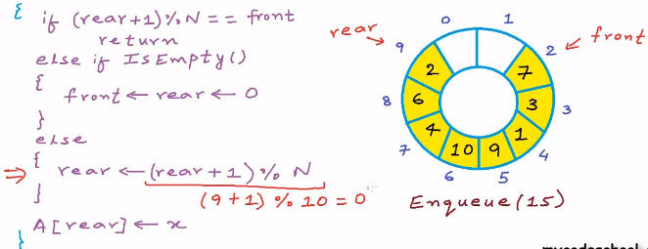
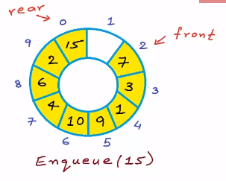
Enqueue(x)

Slide 33
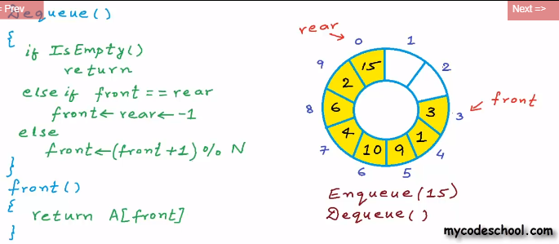
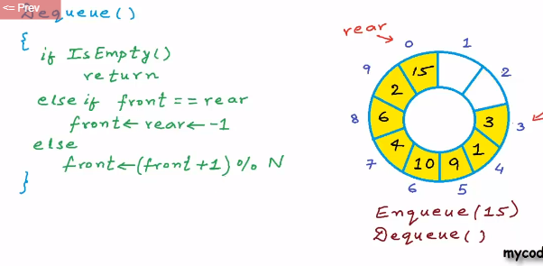
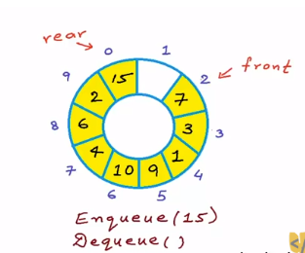
Dequeue()

Slide 34
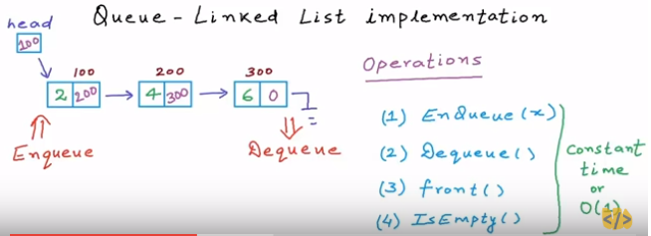
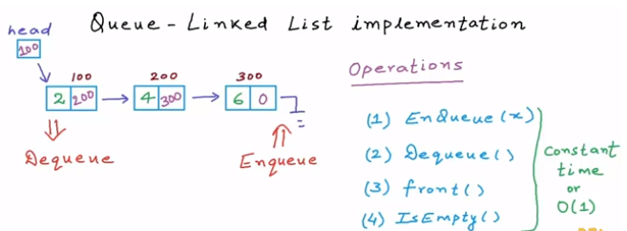
Linked list implementation
Head = front
Tail – rear

Slide 35
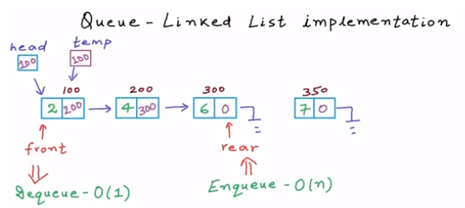

Slide 36
SLL implementation of queues
In an SLL you can easily find the successor of a node, but not its predecessor
Remember, pointers (references) are one-way
If you know where the last node in a list is, it’s hard to remove that node, but it’s easy to add a node after it
Hence,
Use the first element in an SLL as the front of the queue
Use the last element in an SLL as the rear of the queue
Keep pointers to both the front and the rear of the SLL

Slide 37
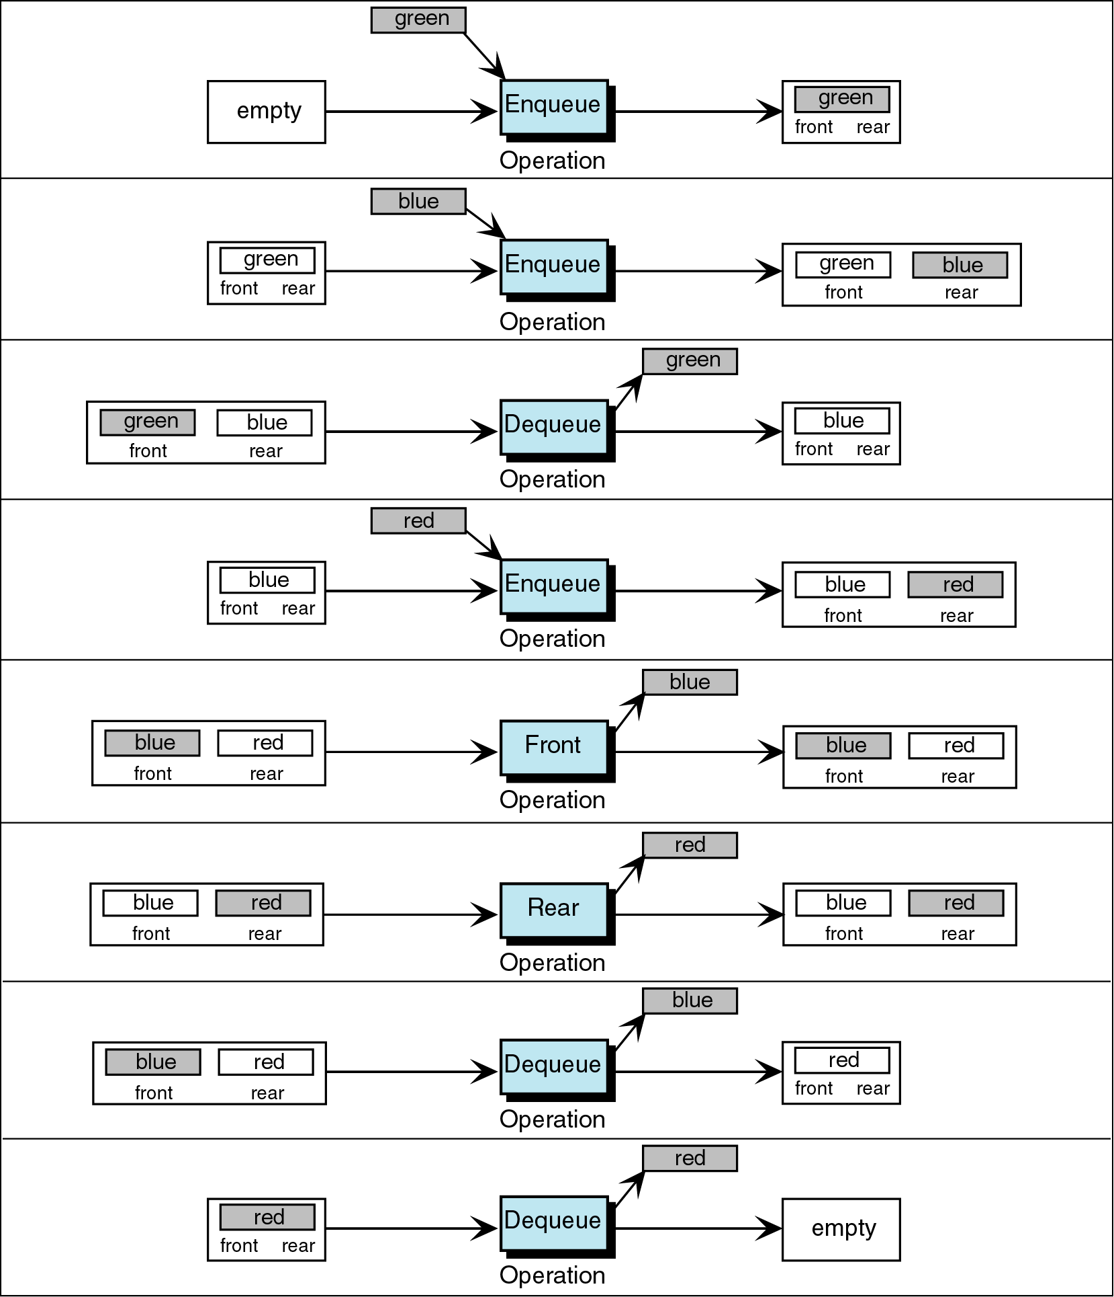
Figure 5-6

Slide 38
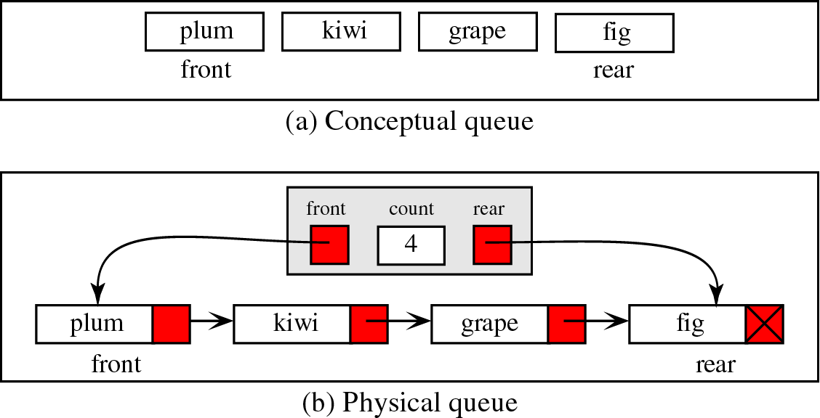
Queue Linked List Design

Slide 39
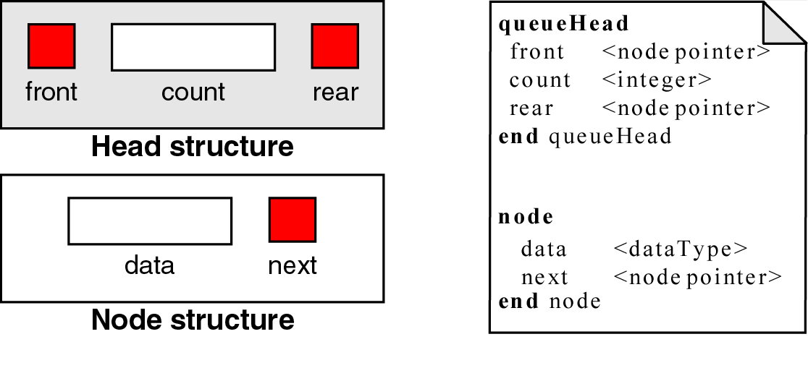
Queue Data Structure

Slide 40
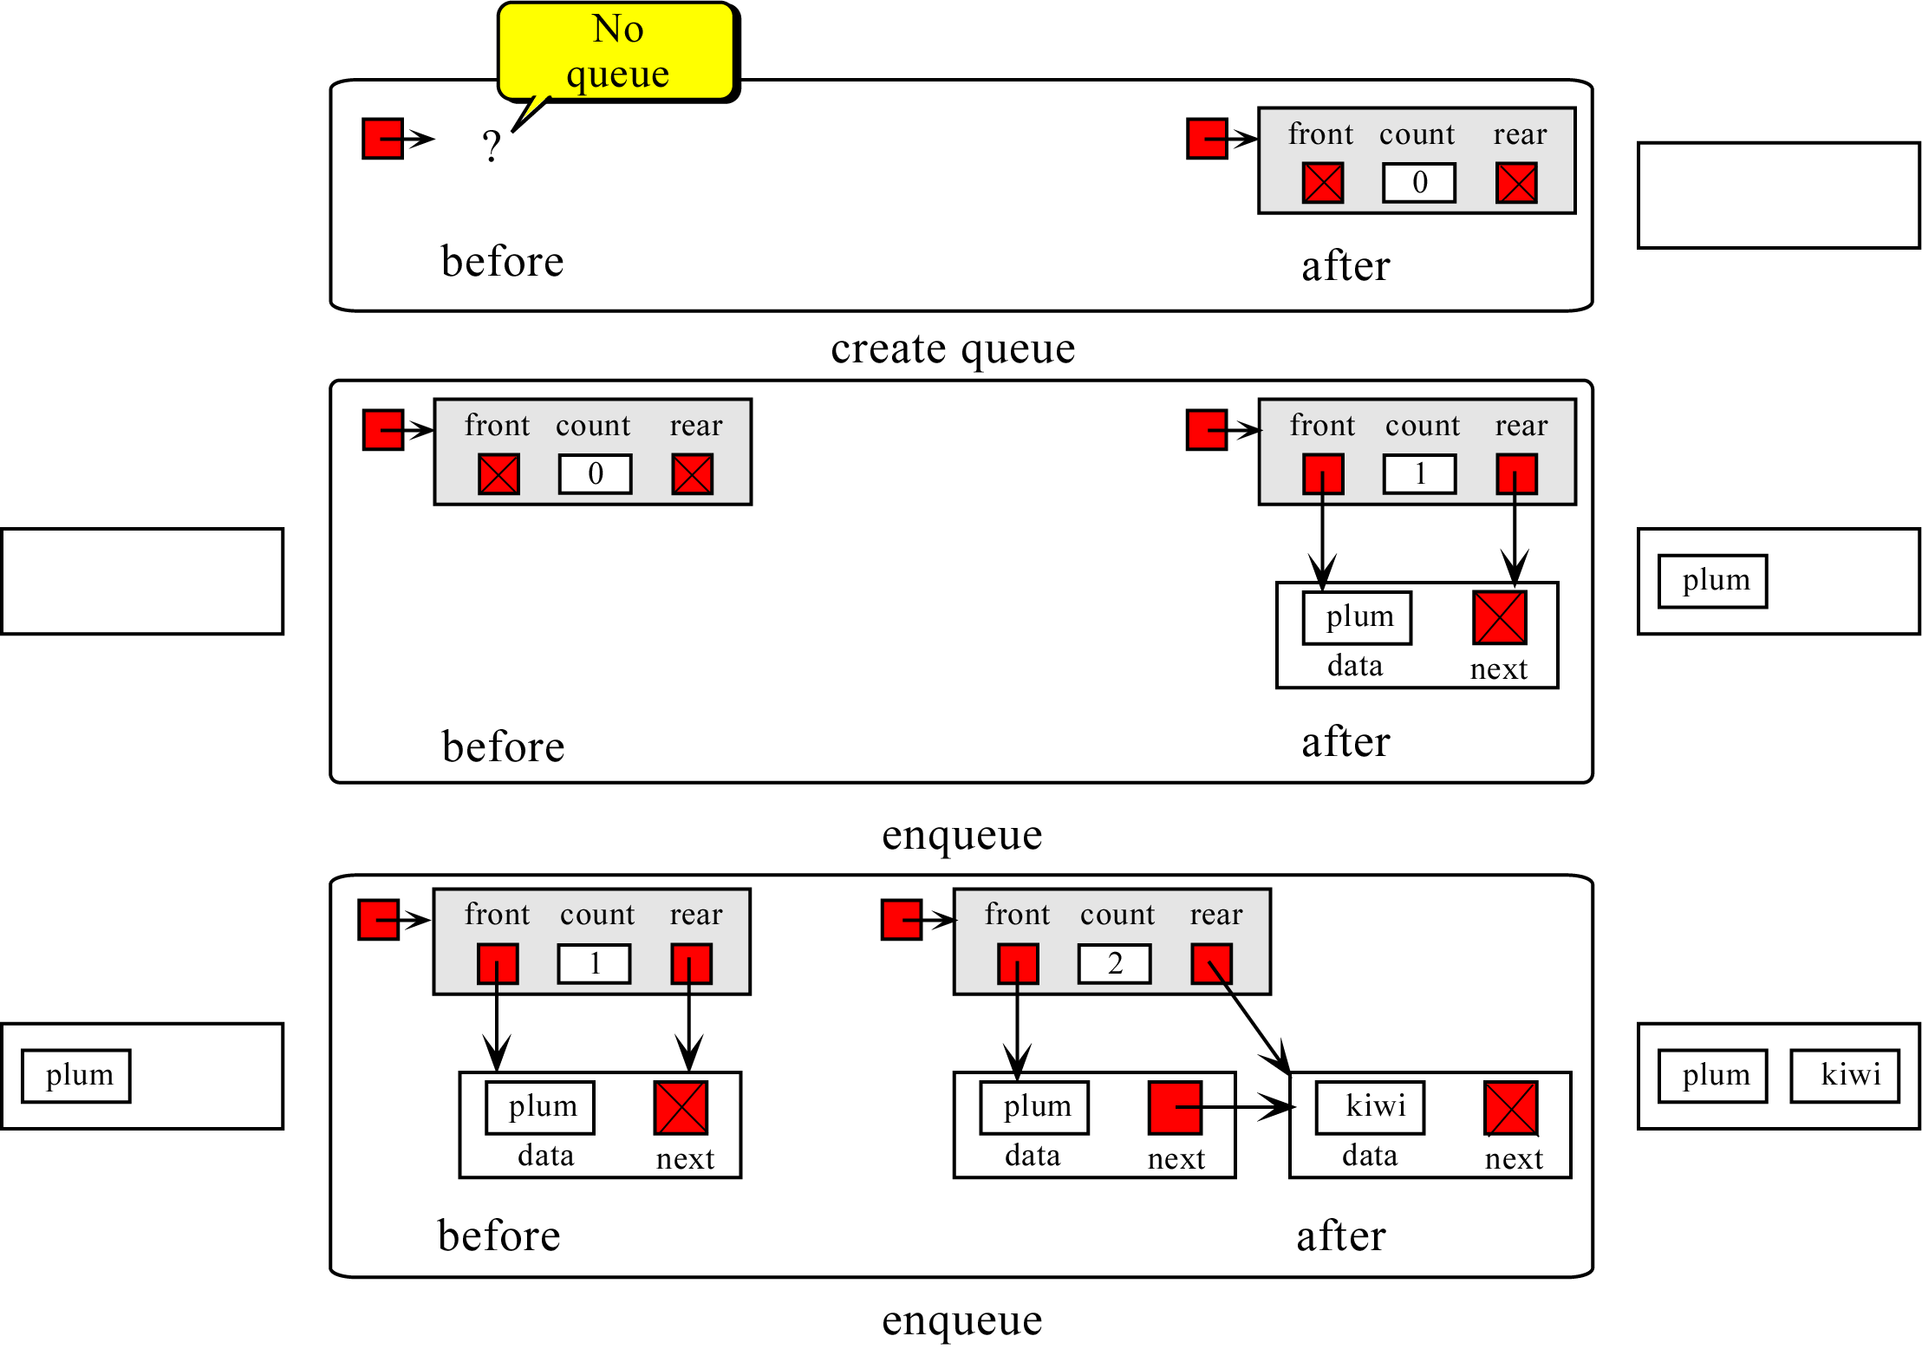

Slide 41
Enqueueing a node
Node to be enqueued
last first
44
97
23
17
To enqueue (add) a node:
Find the current last node
Change it to point to the new last node
Change the last pointer in the list header

Slide 42
ALGORITHM FOR PUSHING AN ELEMENT TO A QUEUE
REAR is a pointer in queue where the new elements are added. FRONT is a pointer, which is pointing to the queue where the elements are popped. DATA is an element to be pushed.
1. Input the DATA element to be pushed
2. Create a New Node
3. NewNode → DATA = DATA
4. NewNode → Next = NULL
5. while(REAR not equal to NULL)
(a) REAR → next = NewNode;
6. REAR =NewNode;
7. Exit

Slide 43
Dequeueing a node
last first
44
97
23
17
To dequeue (remove) a node:
Copy the pointer from the first node into the header

Slide 44
ALGORITHM FOR POPPING AN ELEMENT FROM A QUEUE
REAR is a pointer in queue where the new elements are added. FRONT is a pointer, which is pointing to the queue where the elements are popped. DATA is an element popped from the queue.
1. If (FRONT is equal to NULL)
(a) Display “The Queue is empty”
2. Else
(a) Display “The popped element is FRONT → DATA”
(b) If(FRONT is not equal to REAR)
(i) FRONT = FRONT → Next
(c) Else
(d) FRONT = NULL;
3. Exit

Slide 45
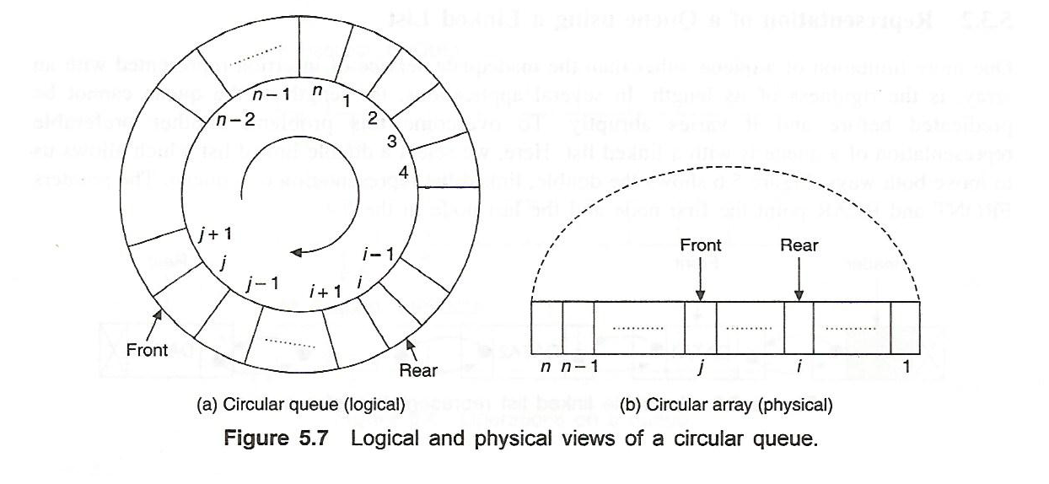
Circular Queue
For a queue represented using an array when the REAR pointer
reaches the end, insertion will be denied even if room is available
at the front.
To avoid this we can use a circular array

Slide 46
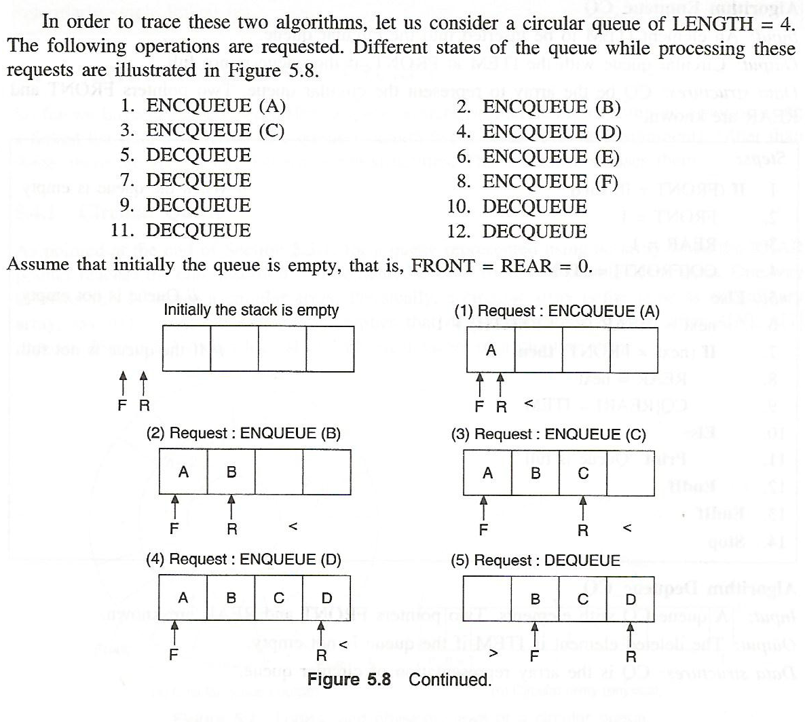

Slide 47
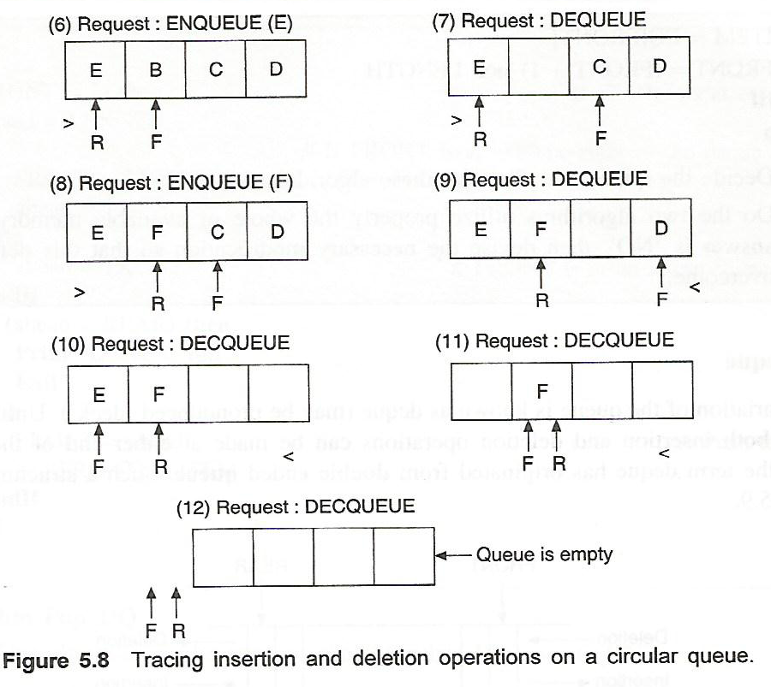

Slide 48
CIRCULAR QUEUE
At any time the position of the element to be inserted will be calculated by the relation Rear = (Rear + 1) % SIZE.
After deleting an element from circular queue the position of the front end is calculated by the relation Front= (Front + 1) % SIZE.
After locating the position of the new element to be inserted, rear, compare it with front. If (rear = front), the queue is full and cannot be inserted anymore.

Slide 49
Algorithm to Insert an element to circular Queue
Initialize FRONT = – 1; REAR = 1
REAR = (REAR + 1) % SIZE
If (FRONT is equal to REAR)
(a) Display “Queue is full”
(b) Exit
Else
(a) Input the value to be inserted and assign to variable “DATA”
If (FRONT is equal to – 1)
(a) FRONT = 0
(b) REAR = 0
Q[REAR] = DATA
Repeat steps 2 to 5 if we want to insert more elements
Exit

Slide 50
Algorithm to Delete an element from a circular queue
1. If (FRONT is equal to – 1)
(a) Display “Queue is empty”
(b) Exit
2. Else
(a) DATA = Q[FRONT]
3. If (REAR is equal to FRONT)
(a) FRONT = –1
(b) REAR = –1
4. Else
(a) FRONT = (FRONT +1) % SIZE
5. Repeat the steps 1, 2 and 3 if we want to delete more elements
6. Exit

